Slide 1
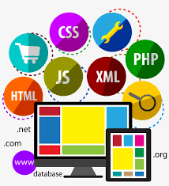
Introduction
to
Web server
Programming
Lecturer: Shakhnoza Muksimova
Email: shakhnoza02@gachon.ac.kr

Slide 2

Lectures:
We meet at 1:00 pm every Friday on floor 2, room 209.
Read the syllabus and policies carefully.
Reading assignments and lab materials will be posted online.

Slide 3
Grading(tentative):
Report 25%
Attendance
10%
Midterm Exam
10%
Group Project
25%
Final Exam
30%
Those who miss 4 classes will be awarded an F.
Homework and Programming projects will be posted online on the class webpage.

Slide 4



Copy from the Internet
Use ChatGPT.
Copy from your friends

Slide 5
Self-Introduction:
What is your name?
Why did you choose this course?
What computer languages do you know?
What are your expectations for this course?

Slide 6
Course Objectives
This course introduces the principles and practices of web server programming, focusing on both front-end and back-end development. It aims to equip students with the skills to design, build, and deploy secure, data-driven web applications.

Slide 7
Course Outcomes
By the end of the course, students will be able to develop full-stack applications, integrate databases, create RESTful APIs, and implement basic security measures. You will also gain practical experience in deploying applications to local and cloud servers.

Slide 8
What Will You Learn in This Course?
In this course, you will learn how the web works, from the client–server model and HTTP to modern front-end and server-side programming. You will gain practical skills in building secure, database-driven, full-stack web applications and deploying them on servers and cloud platforms.

